Slide 1
JSON – What is it?

Slide 2
A Definition
a lightweight data-interchange format.
Human readable and writeable
easy for machines to parse and generate.
based on a subset of the JavaScript Programming Language, Standard ECMA-262 3rd Edition - December 1999.
a text format that is completely language independent
uses conventions that are familiar to programmers of the C-family of languages, including C, C++, C#, Java, JavaScript, Perl, Python, and many others.
These properties make JSON an ideal data-interchange language.

Slide 3
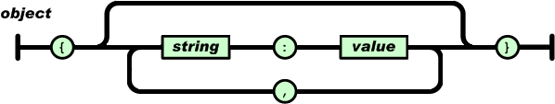
JSON forms - Object
Object is name:value pair

Slide 4
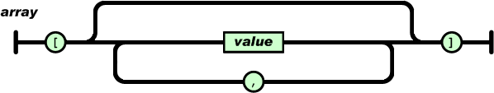
JSON forms - Array
Array of ordered values.

Slide 5
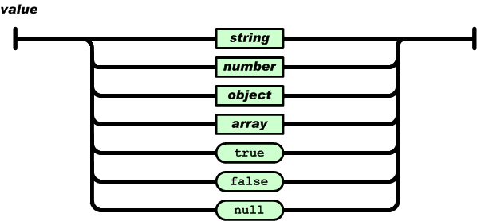
JSON forms - Value
A value can be a string in double quotes, or a number, or true or false or null, or an object or an array

Slide 6
object
{}
{ members }
members
pair
pair , members
pair
string : value
array
[]
[ elements ]
elements
value
value , elements
value
string
number
object
array
true
false
null

Slide 7
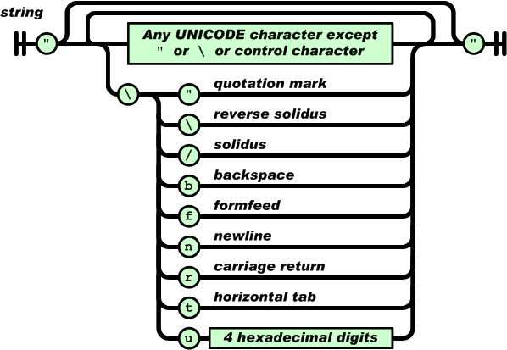
JSON forms - Strings

Slide 8
string
""
" chars "
chars
char
char chars
char
any-Unicode-character-
except-"-or-\-or-
control-character
\"
\\
\/
\b
\f
\n
\r
\t
\u four-hex-digits

Slide 9
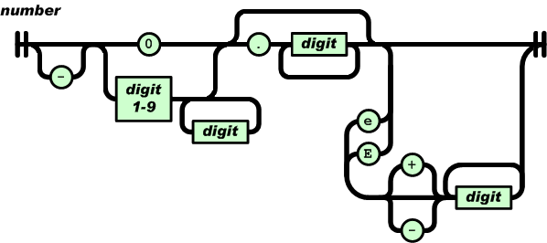
JSON forms - numbers

Slide 10
number
int
int frac
int exp
int frac exp
int
digit
digit1-9 digits
- digit
- digit1-9 digits
frac
. digits
exp
e digits
digits
digit
digit digits
e
e
e+
e-
E
E+
E-

